Slide 1
THE TEAM - (BATCH NO : 2 )
HYDERABAD INSTITUTE OF
TECHNOLOGY AND MANAGEMENT
Design And Implementation of
Traffic Light Control Using Verilog
Student Name Roll number
B.Poojitha. 19E51A0410
B. Sandhya. 19E51A0408
B. Rakesh. 19E51A0413
N. Prashanth Reddy. 18E51A0465
INTERNAL GUIDE : Faculty name, Designation
P.Santhosh,. Assistant professor
MINI PROJECT ACADEMIC YEAR : 2022-2023

Slide 2
LIST OF CONTENTS
Objectives
Introduction
Motivation
Existing model
Specific Project goals
Software requirements
Block diagram / Construction
Flow chart
Circuit diagram
Results
Advantages and Disadvantages
Conclusion
References

Slide 3
MOTIVATION
The Aim of the project is to design and implementation of Traffic Control System using verilog software as this reduce the cost and power consumption of the requirements using in this project rather than using PLD techology and embedded systems which are at high cost.

Slide 4
EXISTING MODEL
Traffic congestion is a condition in transport that is characterized by
slower speeds, longer trip times, and increased vehicular queueing.
When traffic demand is great enough that the interaction between
vehicles slows the speed of the traffic stream, this results in some
congestion.
We can observe traffic congestion mostly at three way, four way
junctions where vehicles are stopped.
There are many existing models for the traffic congestion in embedded
systems like Traffic light control with sensors ,Traffic light control with
timers in which hardware requirements are at very high cost

Slide 5
SPECIFIC PROJECT GOALS
OBJECTIVES OF THIS PROJECT:
Optimize the traffic signal timing of a network of intersection by
evaluating the real time traffic demand in the area.
To reduce delays, shorter queues and decreased travel times.
Co-ordinating signal timing minimizes stating and stopping of
vehicles in the traffic to avoid the traffic jam

Slide 6
INTRODUCTION
The Aim of the project is to develop a Traffic Control System
using Verilog in xilinx software as to reduce cost
of the requirements rather than using sensors,PLD technology
which are of high cost.
we have to implement the Street light controller using the
Verilog code and the later is simulated using Xilinx software and
simulation is done with the ISE Simulator.
Through using Verilog language to the traffic light controller design, the traffic light control circuit uses digital signal automatic control to realize two groups of lights which are red, yellow and green.
Those lights command vehicles and pedestrians passing safely at the crossroad, which bases on the data of traffic state transition

Slide 7
LITERATURE REVIEW
Traffic light control system has been implemented by using Verilog
It has many advantages over other with respect to the speed,
number of input\output ports and performance which are all very
important in the design.
The Verilog code is being used in order to implement the design
and simulation is being tested using xilinx and Isim simulator
whereas in other systems, they use PLD technology by using
sensors, timers, alarms etc...
Complexity is less using Verilog Rather than using Embedded
Systems.

Slide 8

SOFTWARE REQUIREMENTS

Slide 9
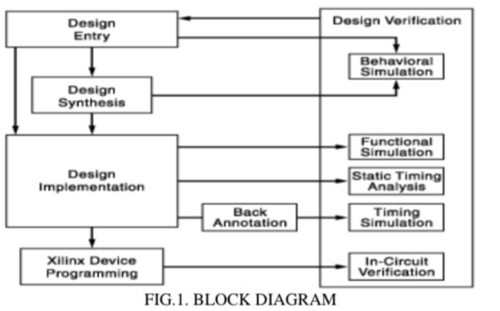
BLOCK DIAGRAM / Construction

Slide 10
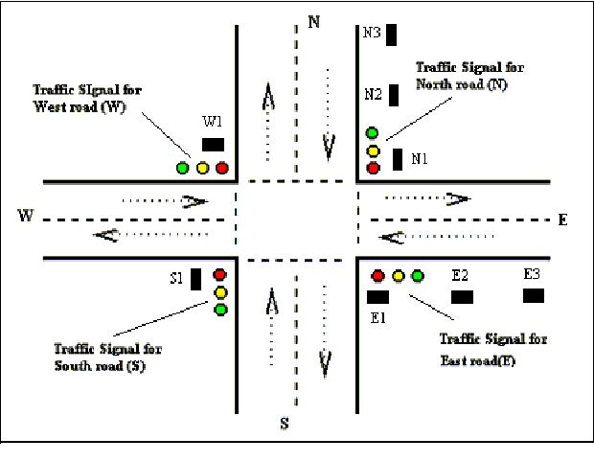
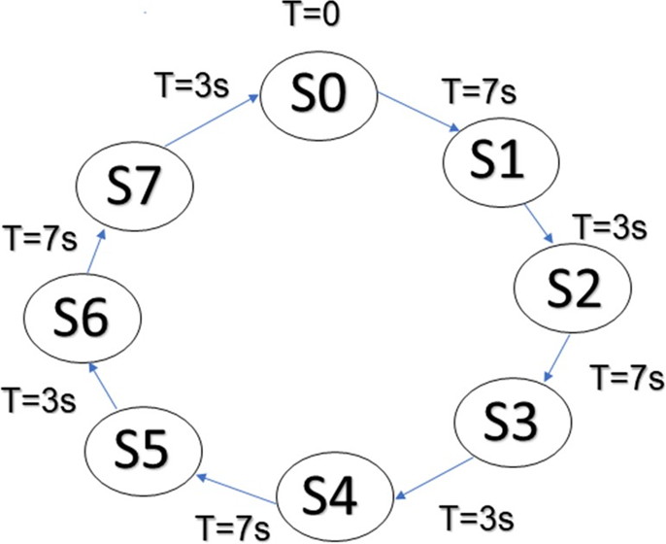
FLOWCHART
Fig.2: Moore’s Machine Cycle
Fig.3: Four Way Junction Road with Traffic lights

Slide 11
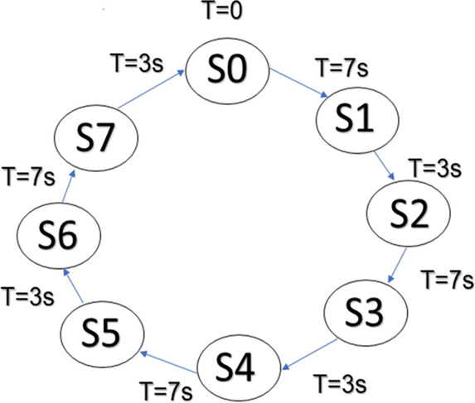
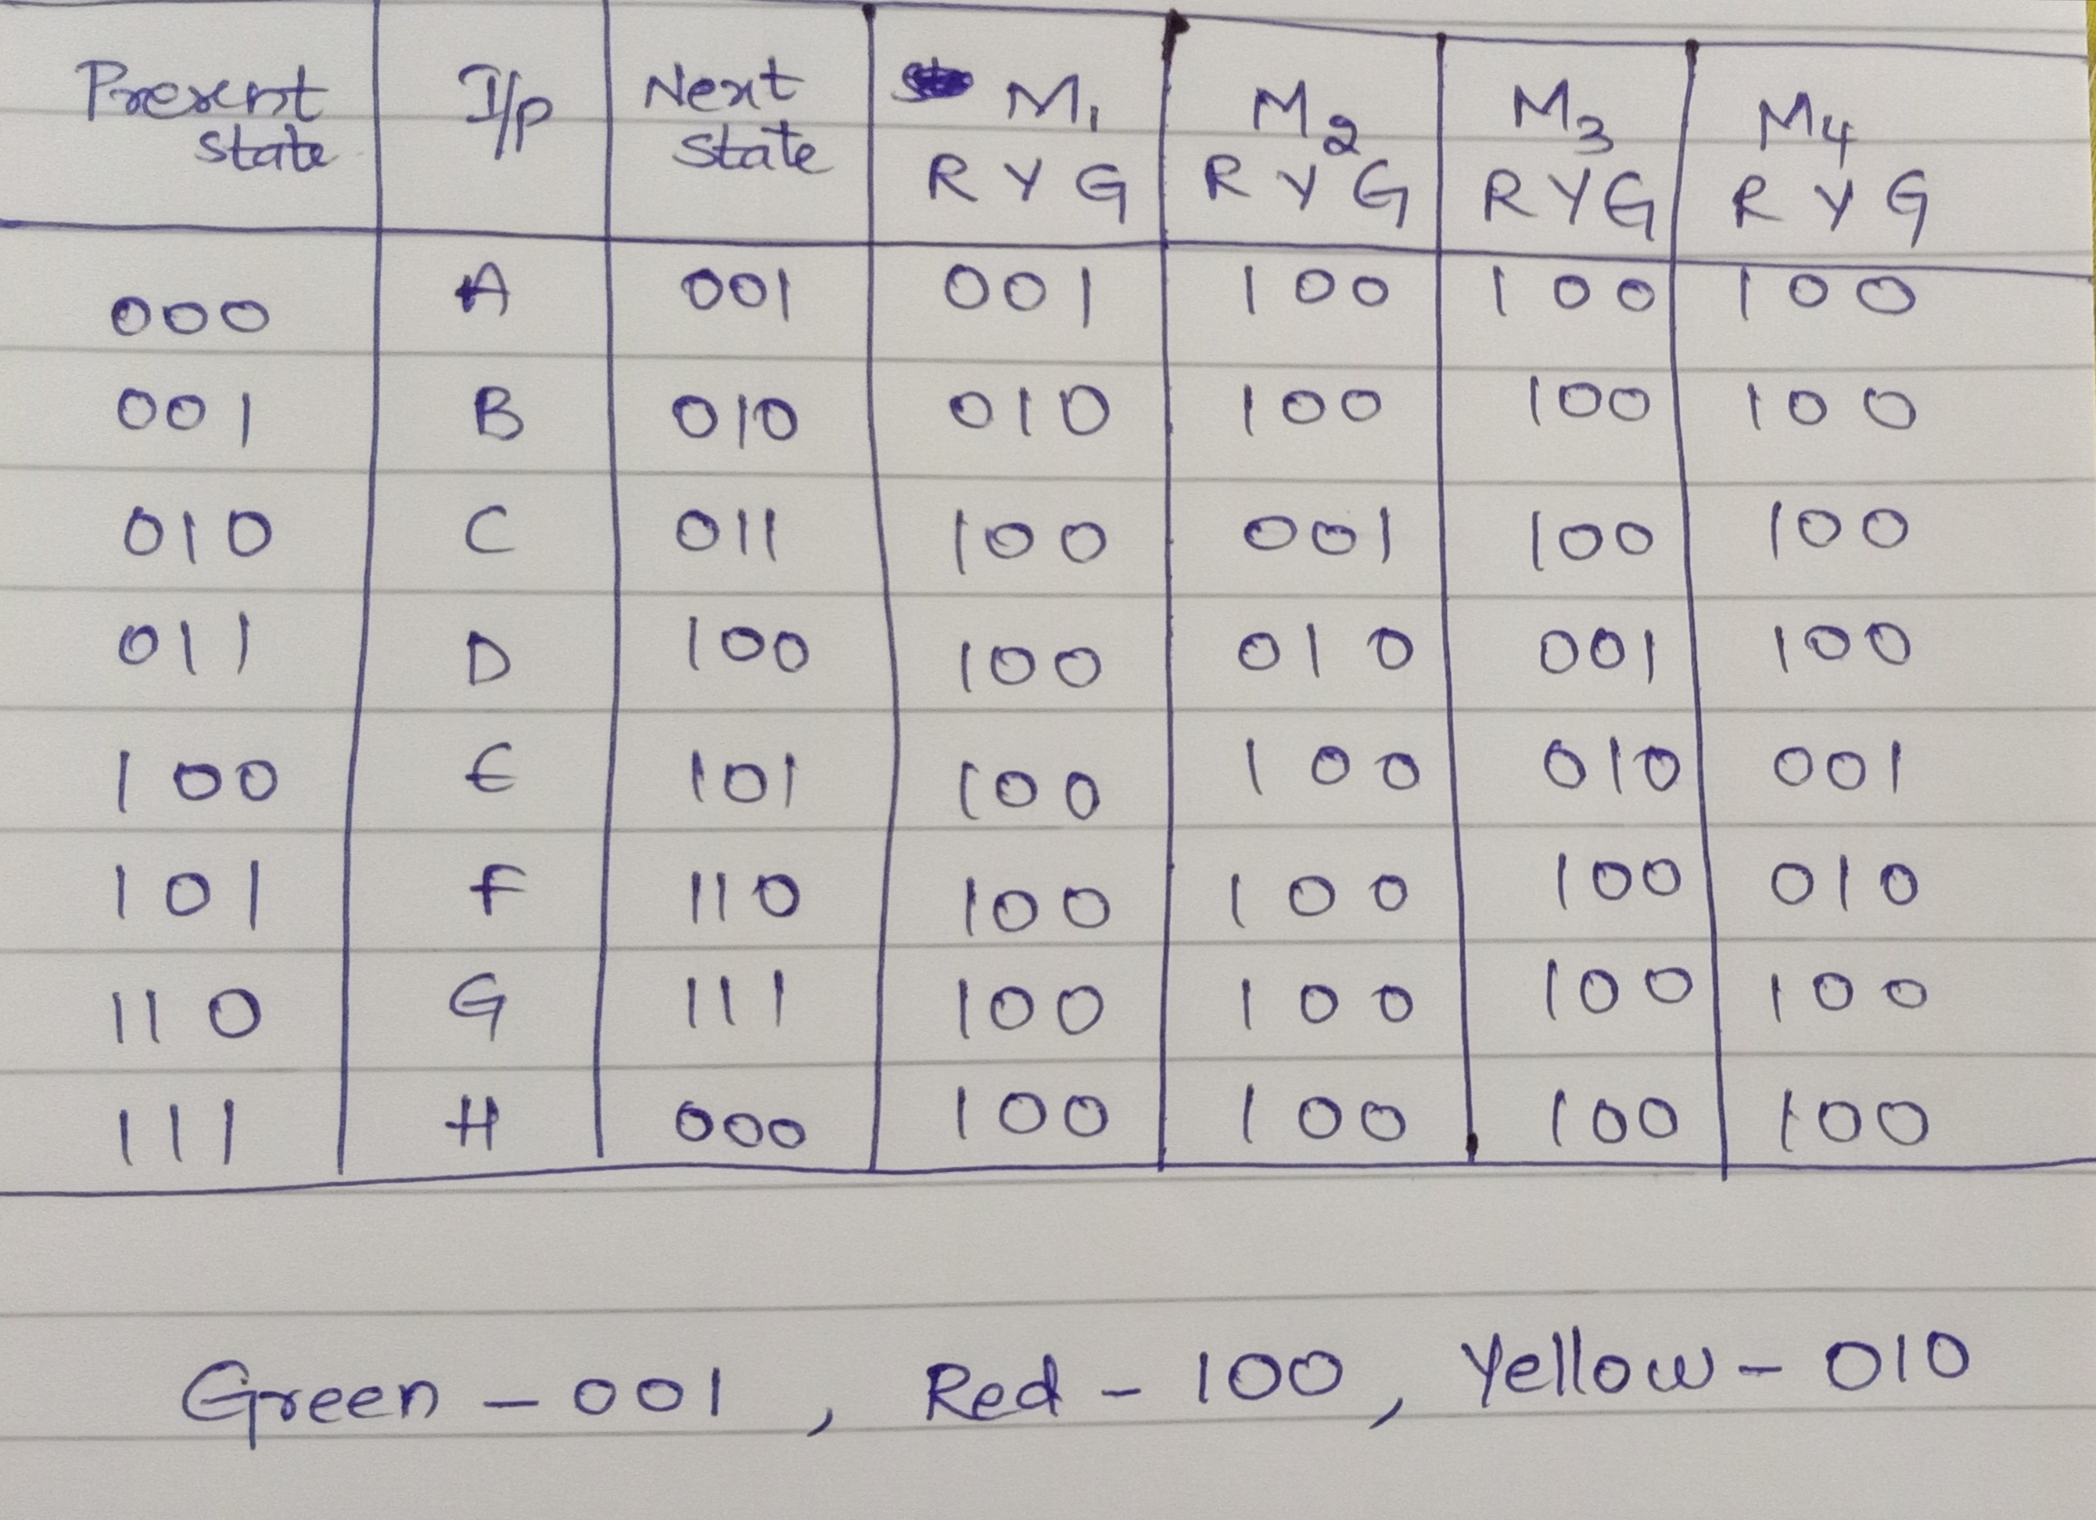
STATE DIAGRAM & STATE TABLE
Fig.5: State Diagram
Fig.4: State table

Slide 12
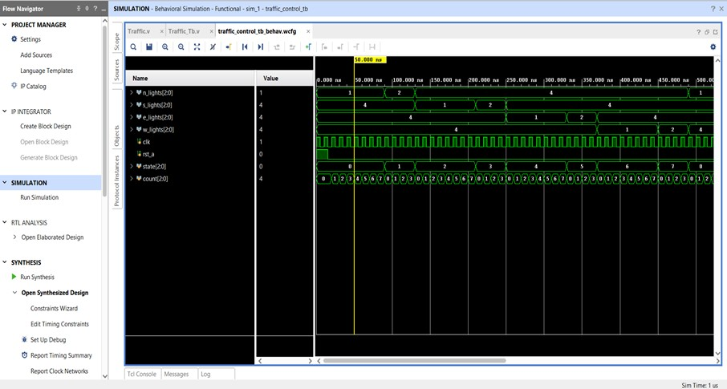
IMPLEMENTATION AND RESULTS

Slide 13
ADVANTAGES
ADVANTAGES:
Helps in reducing the frequency of an accident of some special
nature i.e; Right angle accidents.
They intercept heavy traffic to allow traffic to cross the road
intersection safely.
They direct traffic on different routes without excessive congestion.
It reduces the cost by doing this project in Verilog rather than using
embedded systems.
Power consumption is less

Slide 14
Conclusion
By using this system we can avoid many problems like traffic jams,
accidents and violation of traffic rules to a great extent. We can save
our most valuable time for various other purposes rather than in
heavy traffic jams.
The traffic signals change depending on the priority of heavy traffic
on three colors they are red, green and yellow. Hence in this
project gives effective results.

Slide 15
REFERENCES
[1] https://www.slideshare.net/ChetanDabral1/traffic-light-controller-with-verilog
[2] K.P.R.RATNA RAJU, R.DOLAKSHARI DURGA, B.SRIHARI, M.VENKATA KISHORE, L.BHARATHI, “ DESIGN AND IMPLEMENTATION OF REAL TIME TRAFFIC
CONTROL SYSTEM,Volume IX Issue IV APRIL 2020 ,ISSN : 0950-0707
[3] https://www.skyfilabs.com/project-ideas/design-and-implementation-of-a-real-time-traffic-light-control
[4] Akshay Bidwai1, Abhiyash Hodge2, Hrishikesh Humnabakar3,” Traffic light control system using verilog designing” in international journal of current engineering and scientific research(IJCESR), Volume-5,Issue-7,2018.
[5] https://www.slideshare.net/ChetanDabral1/traffic-light-controller-with-verilog
https://www.researchgate.net/publication/338458961_Design_and_implementation_of_smart_traffic_light_controller_using_VHDL_language

Slide 16
THANK YOU

